Slide 1
Integration Testing
How to make it work for you instead of against you

Slide 2


About Me
Father of two, fighting robot builder, and director of the Technology Enablement Team at EnergyCAP. I enjoy all things engineering, especially inspiring young people to pursue it.
https://www.energycap.com/careers
Zac ODonnell
Director of Technology Enablement
EnergyCAP LLC
zac.odonnell@energycap.com
Let’s Connect!

Slide 3

How do you know it works?
Verifying a complicated software system is like verifying a complicated fighting robot – lots of trial and terror testing!

Slide 4

How do you know it works?
How many of you are using one or more of the following to answer this question?
Finger Crossing
Mostly manual testing
Unit testing
Integration Testing of Backend code
Integration Testing of Frontend code
Browser-based automation testing

Slide 5
Simple Application Architecture
Create Account Screen
Login Screen
Shopping Cart Screen
Product Details Screen
Frontend
User interaction layer
User Controller
Input / Output Reformatting
Product Controller
Backend
Business logic
and storage layer
User Service
Business Logic/Permissions
Product Service
User Repository
Storage Logic / Queries
Product Repository
Storage

Slide 6
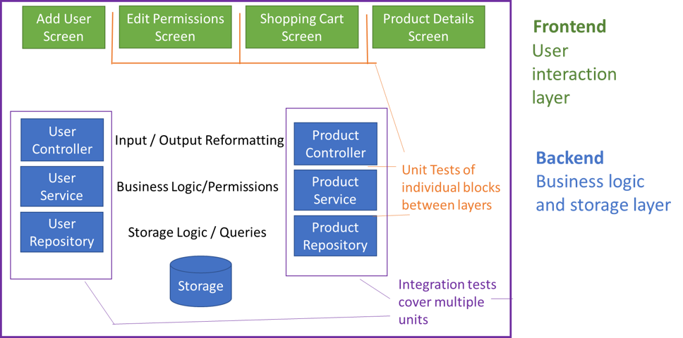
Simple Application Architecture

Slide 7
Microservices make this worse, not better
Create Account Screen
Login Screen
Shopping Cart Screen
Product Details Screen
Frontend
User interaction layer trying to make the chaos cohesive
API Gateway
User Controller
intercommunication
Product Controller
Backends
Isolated teams
iterating separately
Refactoring regularly
assuming compatibility
User Service
Product Service
Business Logic/Permissions
User Repository
Storage Logic / Queries
Product Repository
Storage
Storage

Slide 8
Our Original Approach
Users
Manual Tests
Code Review
Backend Unit Tests
Backend Integration Tests
(less) Repeatability (More)
(low) Cost per Run (high)

Slide 9

What were we missing?
Frontend unit tests
Frontend integration tests
Good testing scenario setups

Slide 10
What was the cost?
Time - Too much time spent on manually searching for problems
Risk – Increased risk when we inevitably need to ship quickly
Repeatability – Too much variation between test runs
Reproducibility – Issues were difficult to fix because we didn’t know how to cause the problem

Slide 11
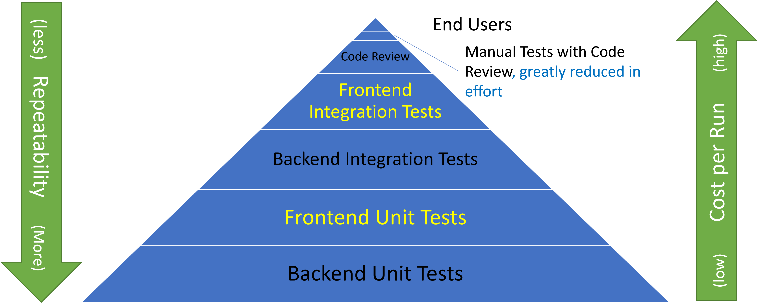
A Different Way

Slide 12
Benefits of a Focus on Browser Automation
The browser really will…
Spot visual differences over time
Both the ones you want and the ones you don’t
Enforce real permissions at the frontend and backend layers
and expose mismatches
Call real APIs
and make sure the data being sent is actually what the API expects
Require real data to be set up to hit each scenario
And uncover places where you can’t set it up or represent a user need
This has unexpected benefits of creating more understanding in the team of real scenarios too
CHEATING

Slide 13
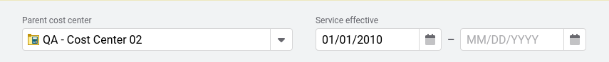
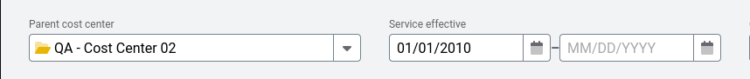
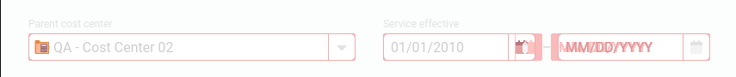
What it is Good For
Visual Regression testing
Borders missing, spacing changes, style conflicts
Library updates
Especially UI libraries like KendoUI, Angular Material, etc
Security vulnerability updates
In your own code and in third party libraries.
“It shouldn’t break anything, right? This has to go out this week!”
Cross-system testing
Dependent APIs, data formats, environmental configuration
In-environment smoke tests
Key scenario “smoke testing” in production
Baseline Screenshot
New Screenshot
Differences

Slide 14
What is it Really Good for?
Knowing that it STILL works after changes
Updating a library or doing a security patch is like replacing a burned-out motor with a spare. Should be fine, right?

Slide 15
Challenges of Browser Automation
It’s the real deal, and reality is messy
Network latency is variable
Isolating tests from each other can be tricky
Some changes are intentional and affect many things
Branding update for colors, logos, or button styles
Some code isn’t perfectly deterministic
Graph output, rounding changes
Noisy test failures and maintenance costs are a major reason people abandon browser test automation.

Slide 16
Challenges of Browser Automation
Noisy test failures and maintenance costs are a major reason people abandon browser test automation.

Slide 17
So what can you do to avoid it?
Build tests like you would production code
Make testability a core requirement of your code where possible
Use it where it thrives, but not where it struggles
Target building for scale, and scalable maintenance

Slide 18

Build tests like you would production code
Keep it DRY – don’t repeat yourself
Review them as rigorously through code review etc.
Have standards for your team for tests too
Valid test data – and an automated way to stage it and refresh it regularly – are vital
The work is not done until the tests prove it works, for real
Maximize the tests not written by getting more coverage for fewer runs – you can often cover several rules with a single test data setup and flow

Slide 19

Make testability a core requirement of your code where possible
Your UI should have selectors that are layout-agnostic
If it goes from one column to three, or needs a wrapper for a background image, it’s still the product name
Selectors should work even if you nest components
Make helpers for complex events that are hard to simulate
Those maintaining the tests must be able to influence the code to make it more testable
Ideally those maintaining the tests are the authors of the code, even if the test plans may come from a different source

Slide 20

Use it where it thrives, not where it struggles
Some things should not be tested this way
Time-sensitive, performance tests, non-deterministic graphs
Multi-user scenarios with overlapping activity
Permutation Testing (unit is better)
Some things are best tested this way
Cross-application flows
Visual comparisons of stable-ish UI
Smoke tests upon deployments

Slide 21
Building for Scale and Maintainability
Time-based pause steps should be avoided
use Element Is Present or Not Present instead, and use the built-in timeouts
Make a modular test to “wait for pending” and use it regularly
Clean selectors
Apps and data change over time
Add ID or specific attributes or classes to keep your selectors agnostic of styling, layout, sequence etc
A picture is worth a thousand words
Favor screenshots and 0% thresholds over individual assertions. They are faster to evaluate and accept on expected changes, and you can get more coverage for less effort.
Focus screenshots to minimum relevant area
Some tools even include some intelligence around identifying and eliminating noise failures
Parallel is powerful
Plan for thousands of tests running nightly.
They need to isolate by user, data source, naming convention, or in-app filtering
Tests must not be order dependent with other tests

Slide 22
Building for Scale and Maintainability
Find or make tools to help you triage
Many products and frameworks produce output or have APIs you can use
Creating an efficient way to look at a bunch of screenshots and say “yep that’s the new correct answer” is critical
Ideally understanding success rate and finding flaky tests could be part of it
Plan for large-scale intentional changes
Branding updates happen every few years (or weeks??)
Plan for frequent updates to staged data for new tests, and a way to clean up
Automatic restores can be useful for this
Require tests to be re-runnable without external reset
Otherwise troubleshooting failures / seeing if you fixed the problem is very time consuming because you must reset everything for all tests
Tests should include reset steps at the beginning to overcome partial-execution when failure happened
Tests must tolerate variable network latency and api response times
When you spin up that contracting group in Costa Rica, they still need to be able to make tests
When your network team decides DB backups run at the same time as your tests, it still needs to run
Tests must be able to be authored efficiently against code that runs locally

Slide 23
Sounds good, but who is going to do all this work?
You can trade off confidence for evaluation frequency
But be careful – if you go too long it may be hard to pin down the cause of real failures – and to spot the signal from the noise
At scale, there are often enough intended changes that the entire suite passing 100% will be uncommon.
If you have flaky tests, fix them or exclude them. Don’t let them add noise until you miss things
Be merciless – is the thing being tested really not possible to make stable? Maybe don’t test it. Is the noise from something the test isn’t targeting? Exclude it from the screenshot!
Creating a duty roster / rotation for the maintainer can share the load
Be careful though – those making code that causes noise should get their turn to deal with the noise, or there is less incentive for it to go away

Slide 24






So many tools, so little time!
WebDriver.IO

Slide 25
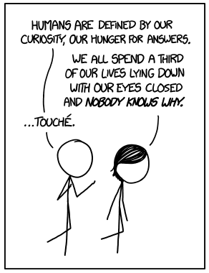
Questions?
Zac ODonnell
Manager, Product Engineering
zac.odonnell@energycap.com
Credit: XKCD - https://xkcd.com/1345

Slide 26
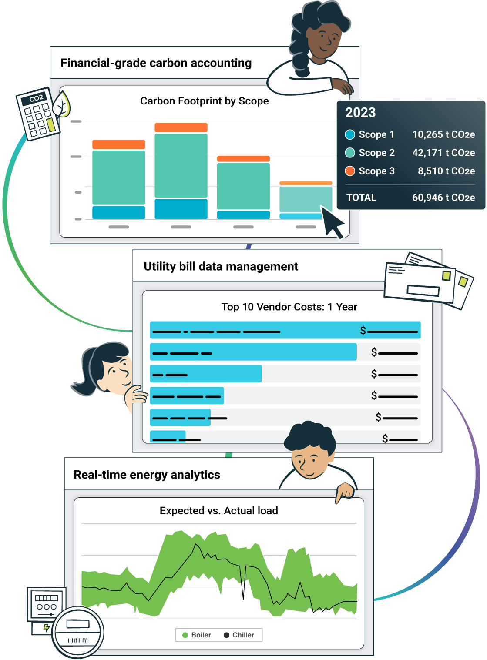
The single source of truth for energy and sustainability teams
Our energy and sustainability software gives you instant access to actionable data you can trust to better manage resource consumption, reduce your carbon footprint, and drive massive savings.

Slide 28
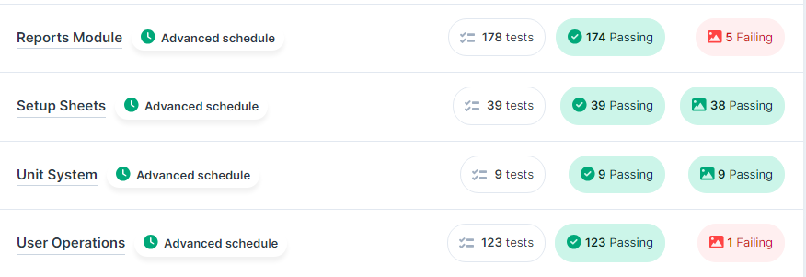
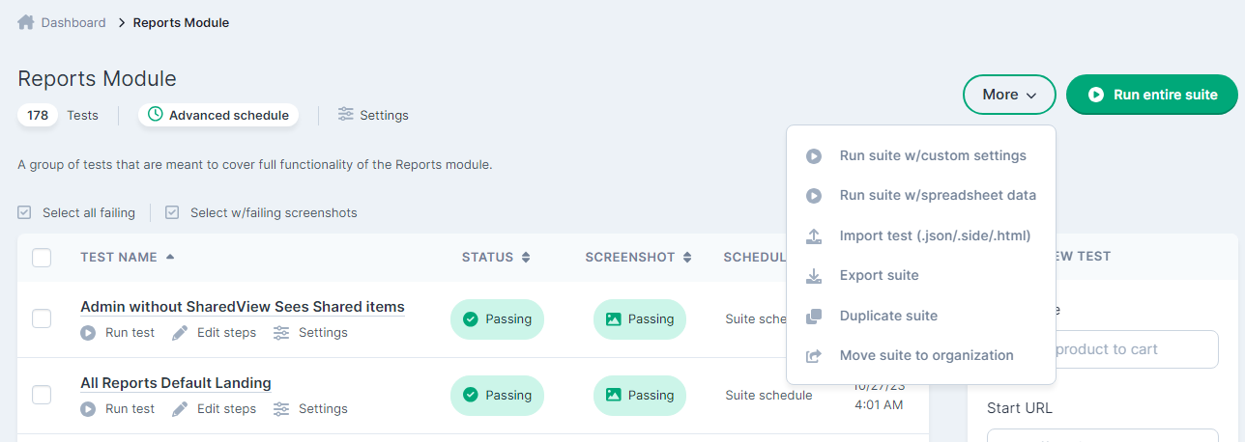
Ghost Inspector: a Browser Testing Platform
Test suites can run on a schedule, showing where you stand all the time
Suites and tests can be run with different settings for environment, users, etc, and tests can be run, exported, or imported in bulk

Slide 29
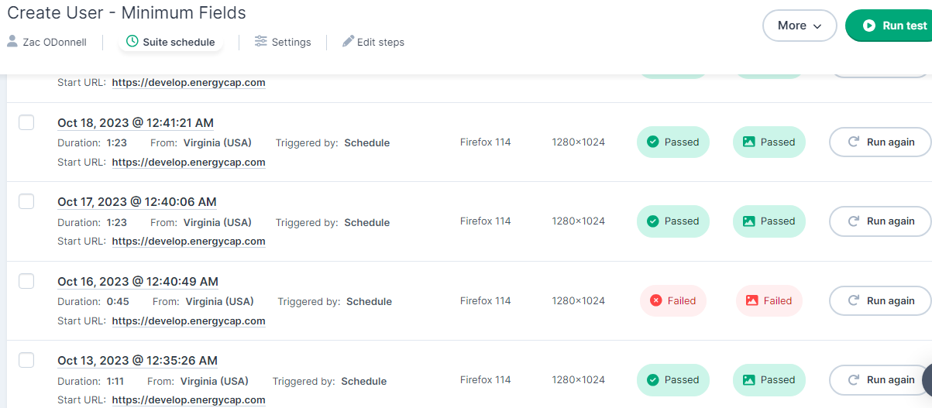
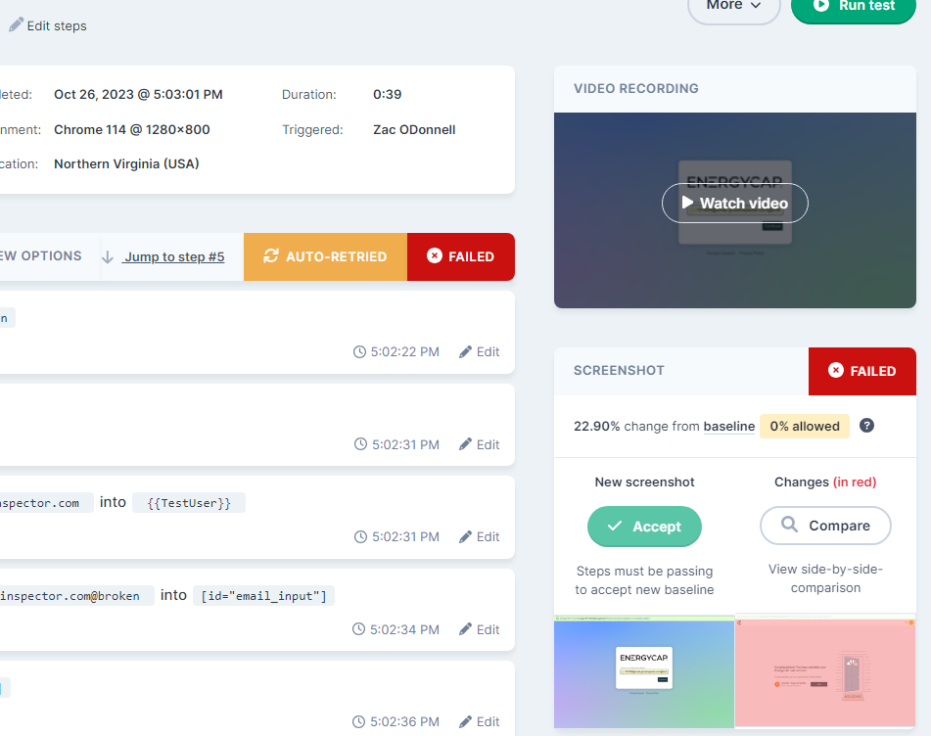
Ghost Inspector: a Browser Testing Platform
Individual tests have history with recordings and variable snapshots to allow replay so you know when and how something broke
Built-in retry handling minimizes noisy failures caused by environmental issues
Logical assertions, unavailable interactions, and visual differences are all captured and can be compared and replayed later.

Slide 30
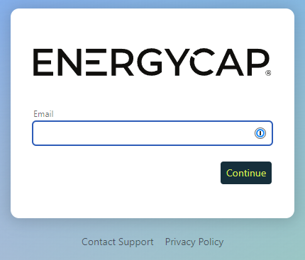
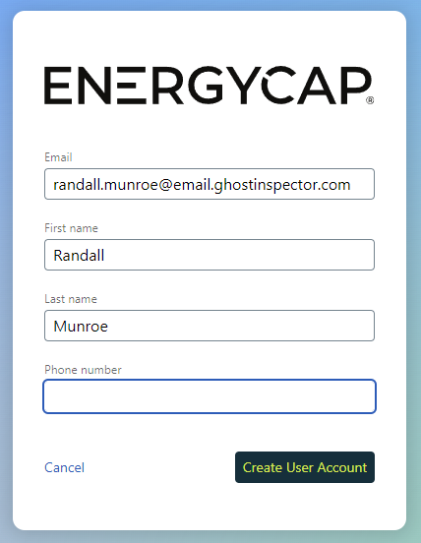
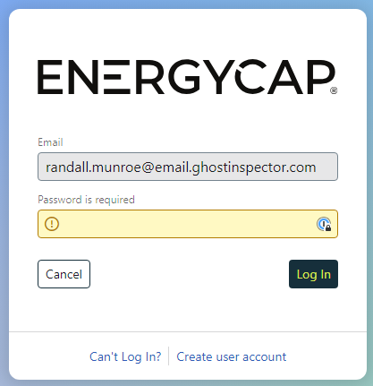
Show Me – Creating a New Account

Slide 31

Show Me – Creating a New Account

Slide 32
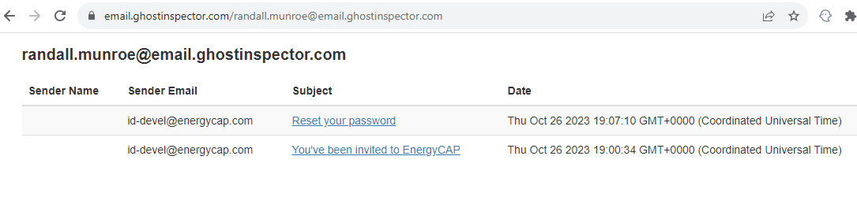
Email Activation
Built-in transient email box for test emails (1 hour lifetime)
Dedicated url path allows linking to inbox
/latest route allows deep linking to dynamically generated email content
Publicly visible with no authentication so be careful what emails you’re sending there and what they provide access to

Slide 33
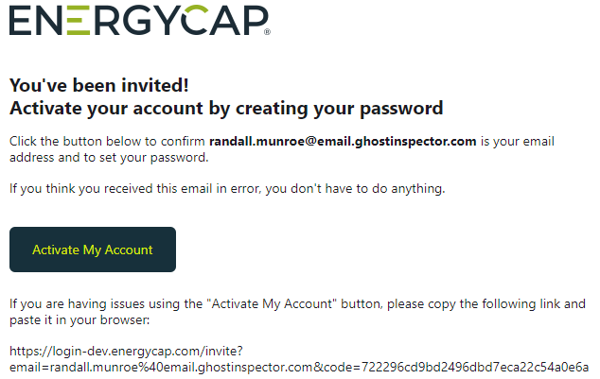
Email Activation
Example email viewer that allows you to assert on and click links in emails during the test.
Very useful to ensure image and style content is actually sent with the emails
Interprets email as a web page, which can differ significantly with how some email clients render it.

Slide 34
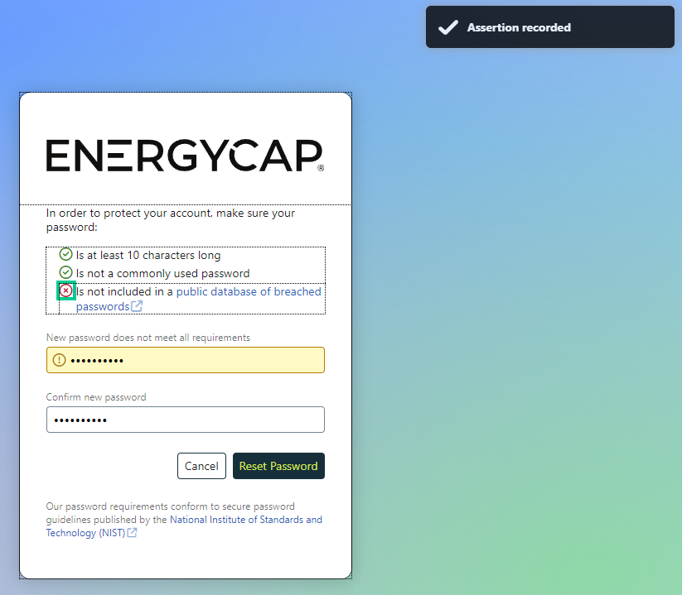
Email Activation and Setting a Password
Allows screen interactions and assertions on screen state
Can capture screenshots along the way for archival purposes
only compares the final screenshot for the test with historical results

Slide 35
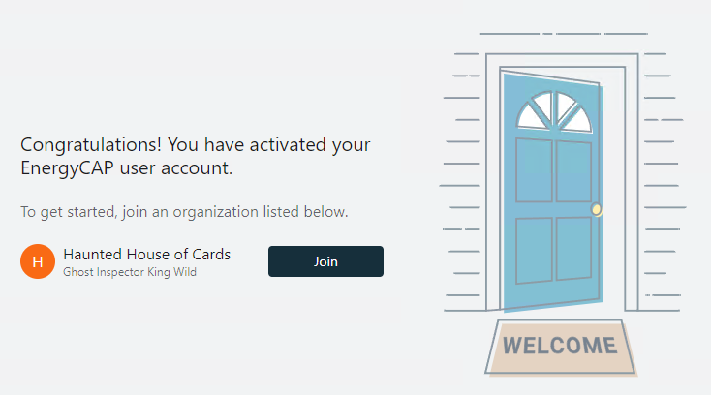
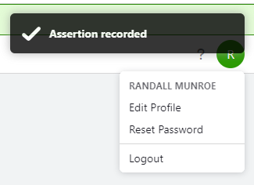
Final Validation
Final screenshot can validate success of the process as well as visual styles of the final page

Slide 36
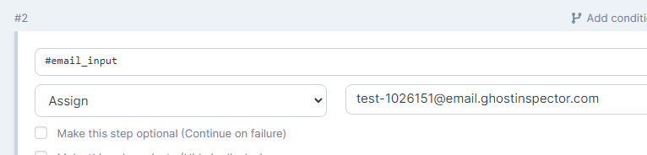
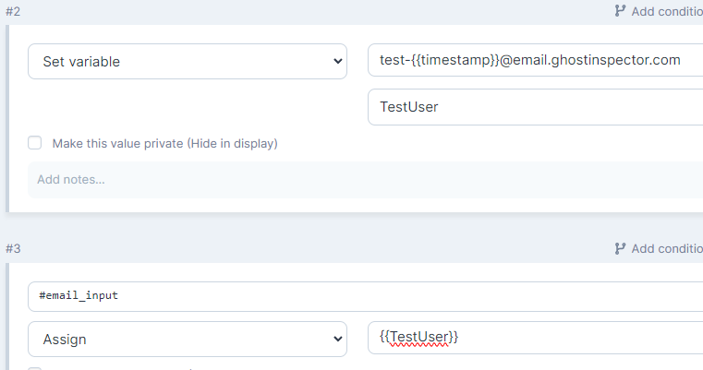
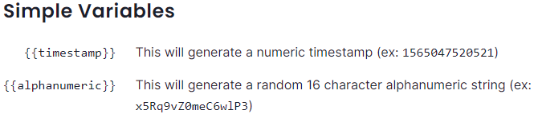
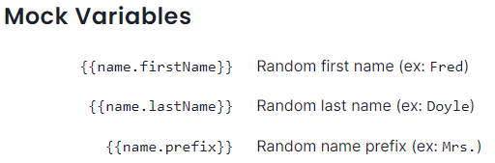
Polishing the Recording
Items that must be unique for each run must be dynamic (new account email, etc)
Built-in variables for timestamp, names, etc available
Capturing variable state for use in later assertions is useful

Slide 37
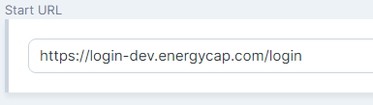
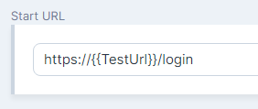
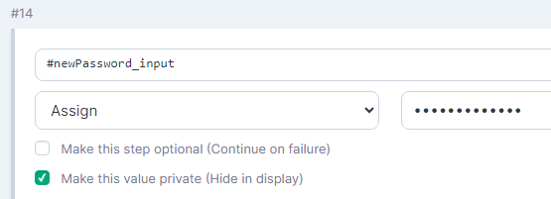
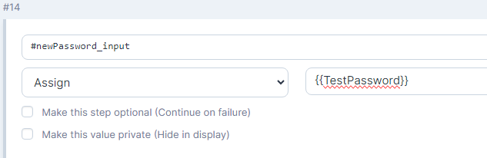
Polishing the Recording - Variables
Use variables to allow the test context to
define where and how it runs
TestUser – if test could log in with different user
TestURL (for the root)
Allows switching target from local, to development, to production
Passwords
Allows storing passwords outside of the tests, for easier rotation and lower exposure
You’ll want to re-check “make this value private” to avoid the replacement showing up in the post-run steps

Slide 38
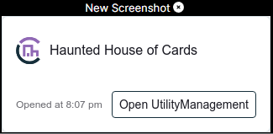
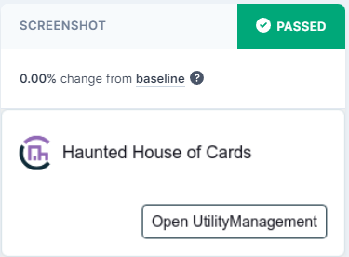
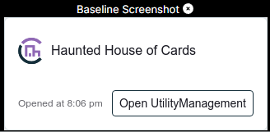
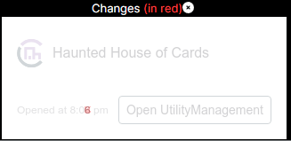
Polishing the Recording - Screenshots
Set screenshot target and exclusions to keep the test reliable
You don’t want activity dates that change on every run to break your screenshots
Don’t be tempted to just increase the tolerance – zero tolerance is the best policy!
If the test is about interactions and the visual aspect is covered elsewhere, disable the screenshot to reduce noise

Slide 39
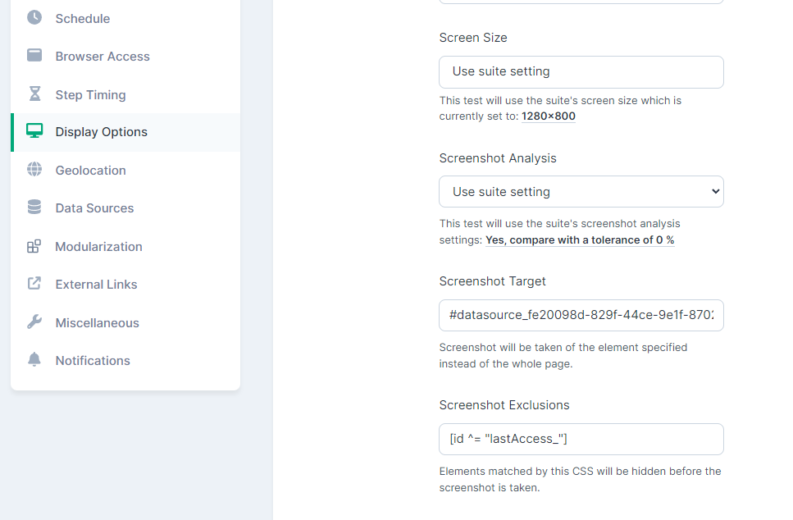
Polishing the Recording - Screenshots
Target and Exclusions are set in the test display options
You can include multiple selectors, comma separated
Layout is not affected, only the screenshot
Supports any CSS3 selector
Here the ID of the specific datasource card is stable so it can be used
Matches any ID attribute that starts with lastAccess, to cover multiple blocks if needed

Slide 40
Favorite Features
Built in timing / delay handling
Built-in Email handling
Sample Data Generation
multi-level variable system
Recording playback and screenshot comparisons, with history
Modular Tests / Imports
Flexibility with JS steps
Import/export portability

